Slide 1
System Design Live
Week 1 - Foundational Ideas

Slide 2
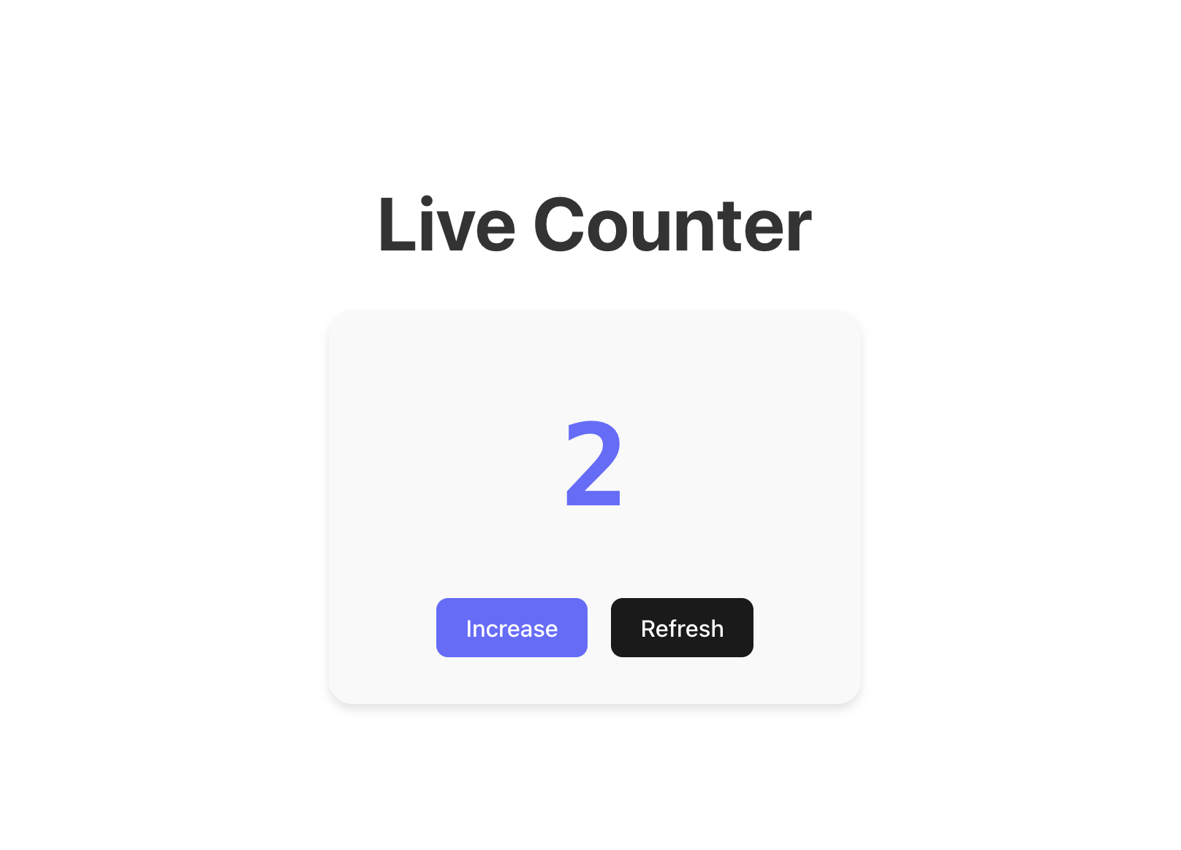
We will understand all this with an example site.

Slide 3


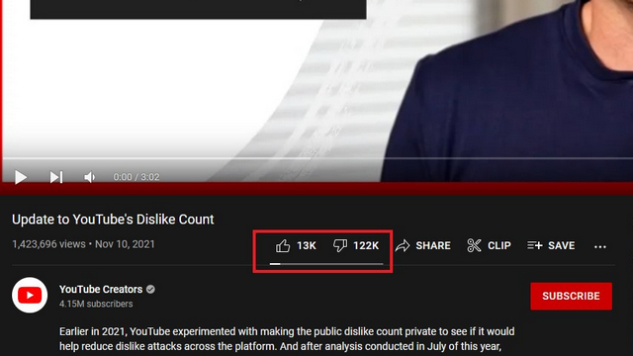
And this is not just an dummy …

Slide 4
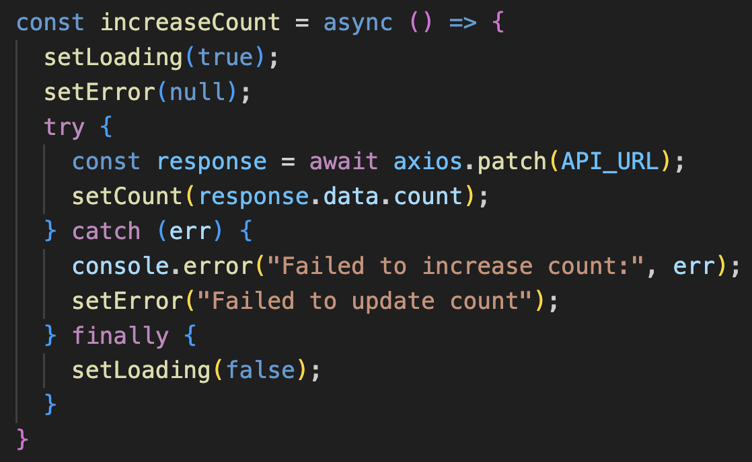
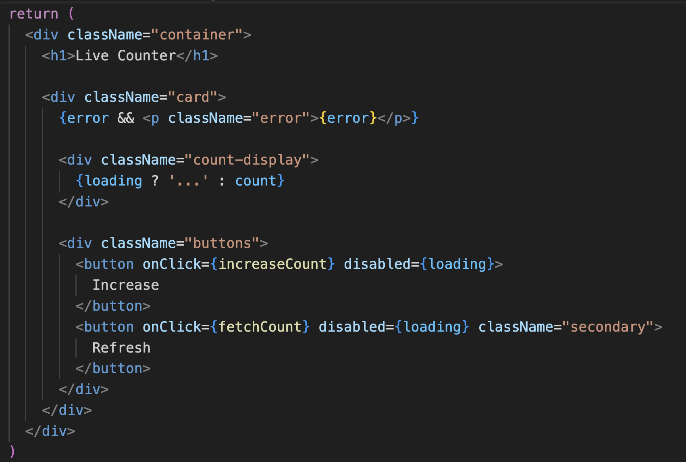
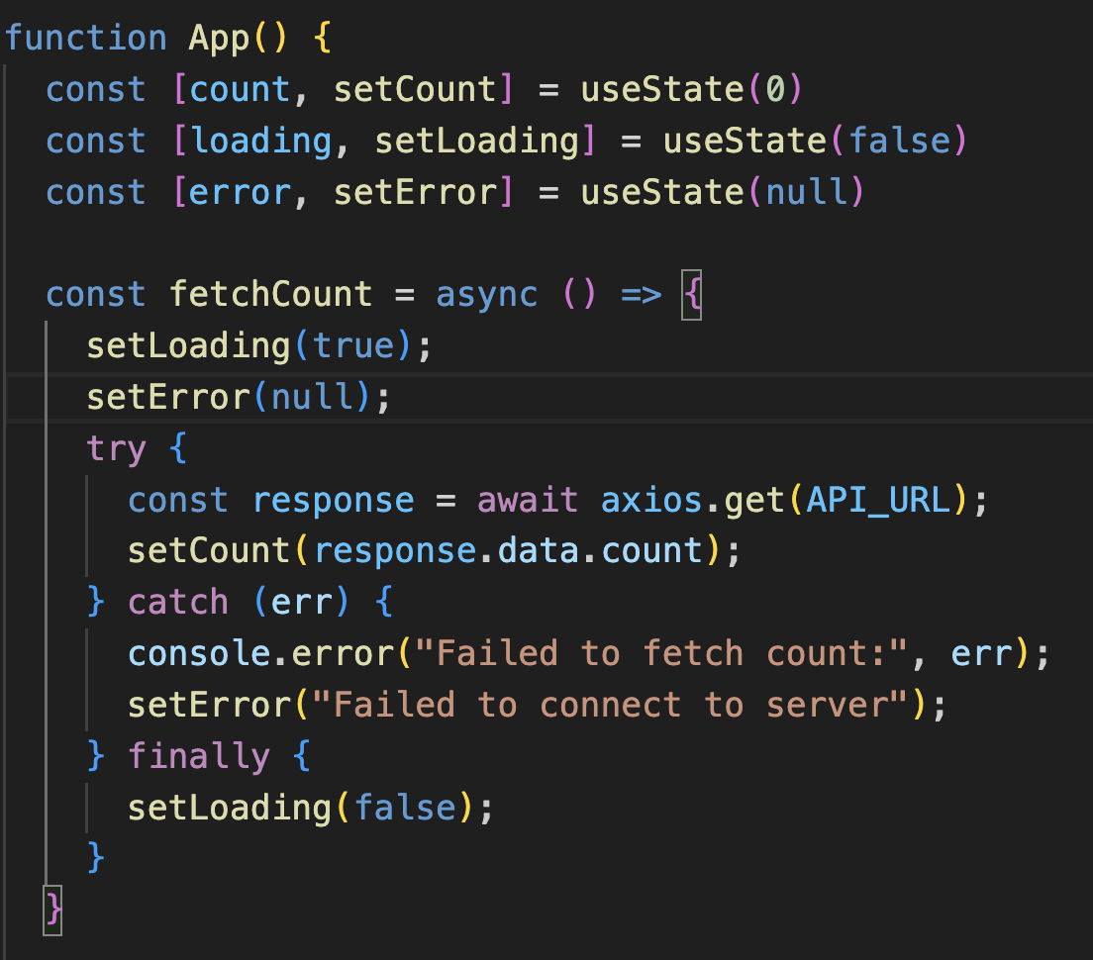
Frontend (React)

Slide 5
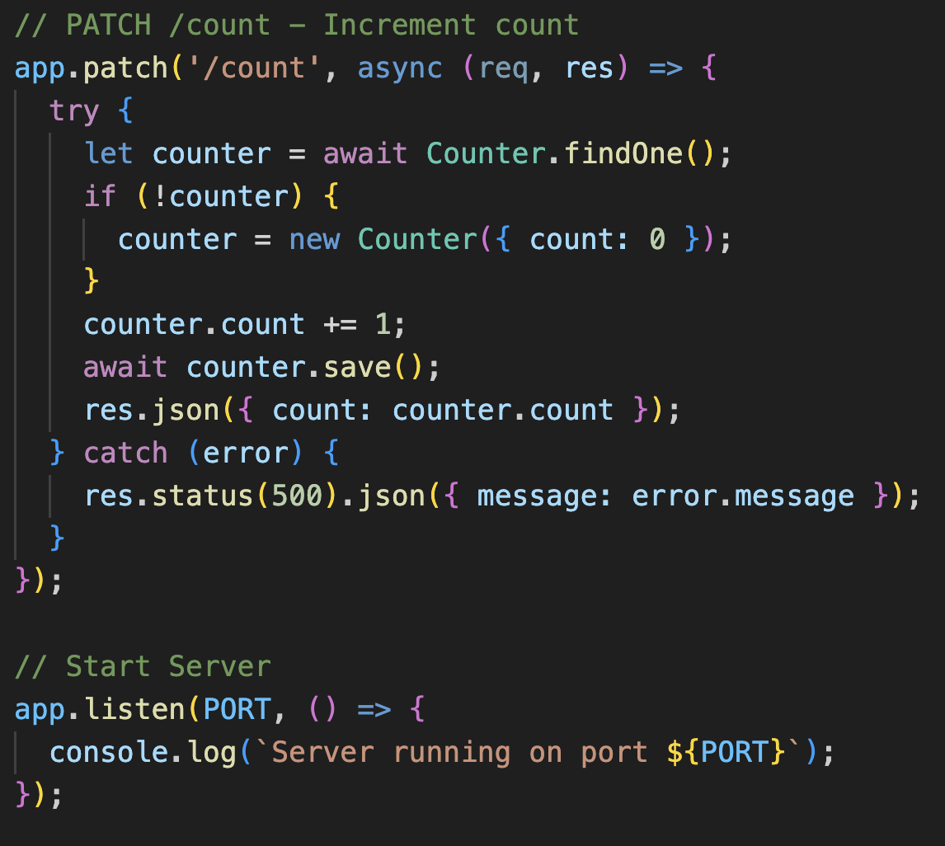
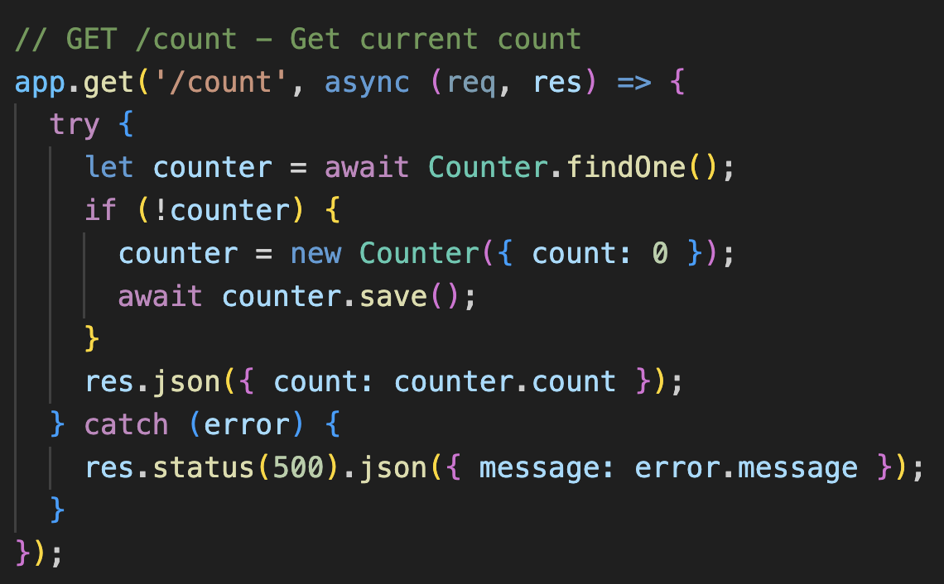
Backend (Express)

Slide 6
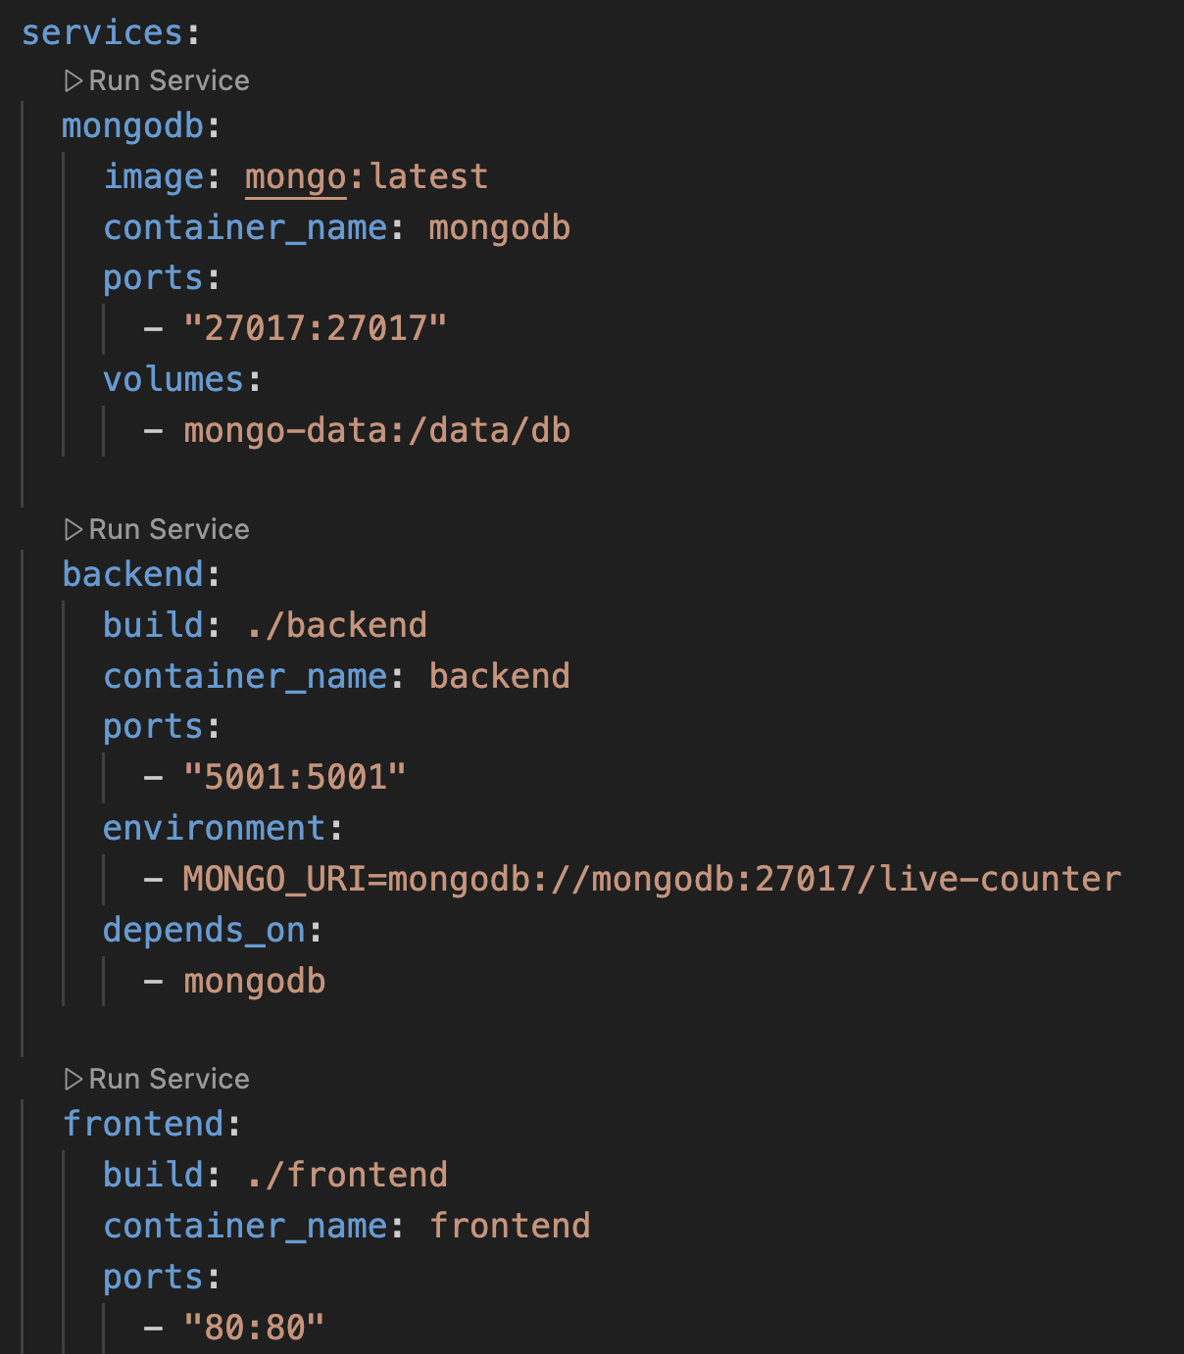
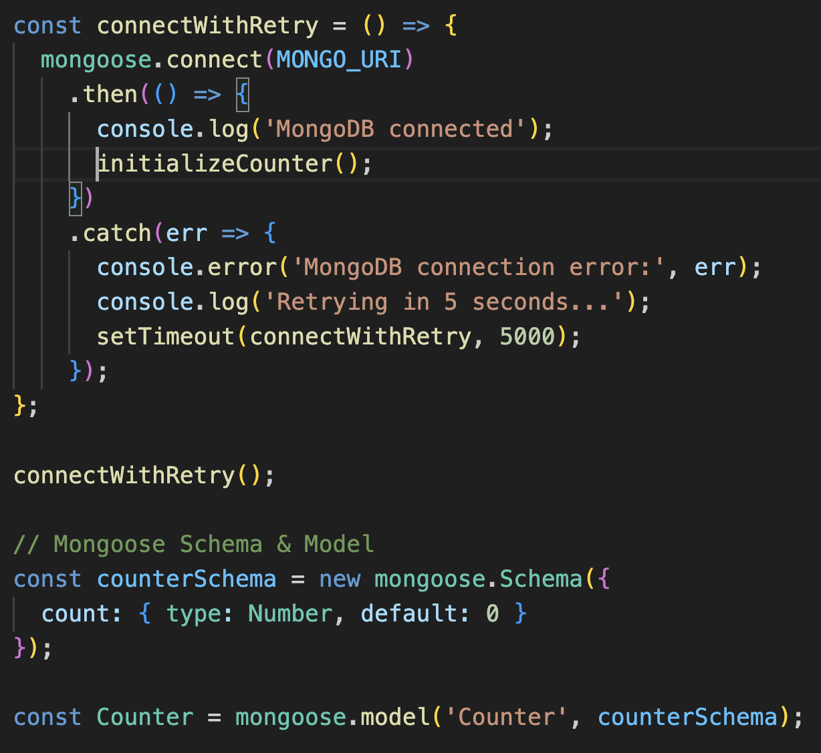
Database + Docker (MongoDB)

Slide 7
Anyone who learns Development can build this and make it work on their PC.
Learner
(DEV)
HTTP/HTTPS basics
Client–server architecture
REST APIs
Databases (SQL/NoSQL)
Authentication & authorization
Git & version control

Slide 8
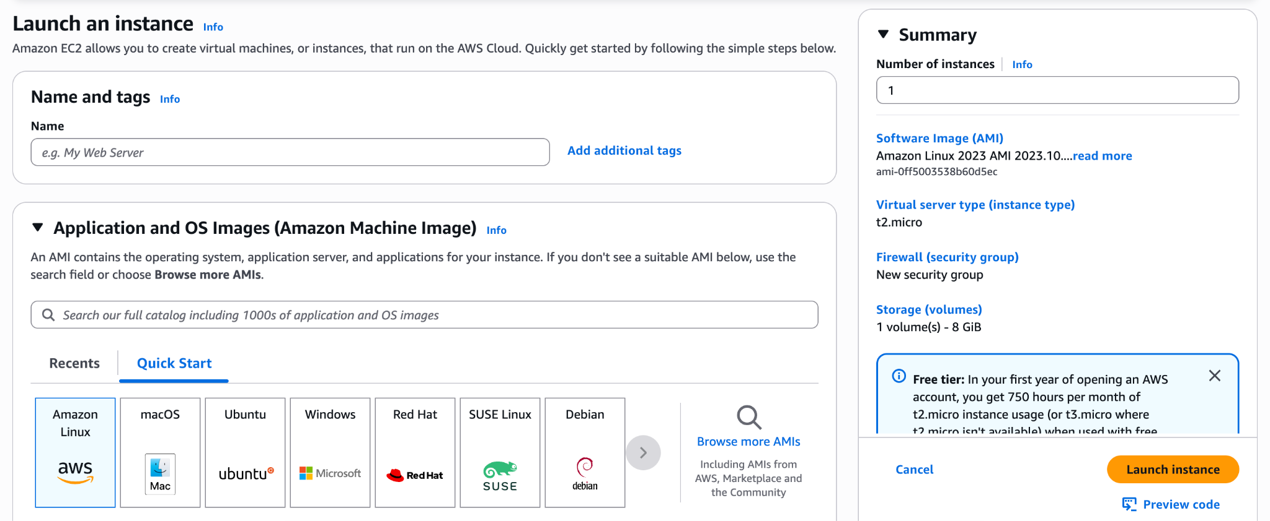
Understanding of one Cloud Platform
Debugging & logging
Deployment & hosting
Environment variables & configuration
Testing (unit/integration)
Learner
(DEV)
Junior Engineer
(DEV + CLOUD)

Slide 9
But this is not what gives you an edge…
Learner
(DEV)
Junior Engineer
(DEV + CLOUD)
Mid-Level/Senior Engineer
(DEV + CLOUD + ??????)

Slide 10



A Junior Engineer sees the data flow.
API Call
Query to DB
It returns the count
Sends back to Frontend to Show
counter = 2
GET /counter
SELECT * from COUNTER

Slide 11
A Senior Engineer sees potential issues.
What if too many users use it simultaneously.
What if the server crashes?
What is the limit of Database
Connection issues… and many more.
counter = 2
GET /counter
SELECT * from COUNTER

Slide 12
A Senior Engineer asks the right questions
“If 1 million users call GET /counter, what happens?”
“If 100 users call it at the exact same time?”
“If DB is slow or down?”
“Is counter=2 always correct?”
What does the product needs??
counter = 2
GET /counter
SELECT * from COUNTER

Slide 13
Before we solve, framing Requirement is Critical!
A requirement is a statement that defines:
What the system must do (behavior), and/or
How well it must do it (quality constraints), and/or
Under what conditions (scale, failures, security, compliance).
Bad: “It should be fast”
Good: “p95 latency < 200ms at 5k QPS”

Slide 14
Main types of requirements [interview view]
Functional Requirements (FR)
1. GET /counter returns current counter value.
2. POST /increment increments counter by 1.
In some other cases …
... “User can upload PDFs”
... “Search returns top 10 results”

Slide 15
Main types of requirements [interview view]
B) Non-Functional Requirements (NFR)
Quality attributes: how good the system must be.
… and this is where seniority starts showing up.
Performance (Latency)
Throughput (Capacity / QPS)
Scalability (Growth handling)
Availability (Uptime)
Reliability (Correctness under failures)
Consistency (Strong vs Eventual)
Durability (No data loss)
Security (Auth + Abuse protection)
Observability (Logs, Metrics, Tracing)
Maintainability / Operability (Safe changes & deployment)

Slide 16
Performance (Latency)
Scalability
Meaning: How fast responses are.
Requirement: GET /counter p95 < 100ms, POST /increment p95 < 150ms
Meaning: Ability to grow smoothly as users/traffic grows.
Problem: POST /increment hits the same DB row → hotspot

Slide 17
Throughput (QPS / Capacity)
Reliability (Correctness under faults)
Meaning: How many requests per second you can handle.
Requirement: Support 10k QPS GET + 2k QPS increment
Meaning: Works correctly even when things fail (timeouts, retries).
Risk: Client retries POST /increment → double increment
and many more …

Slide 18
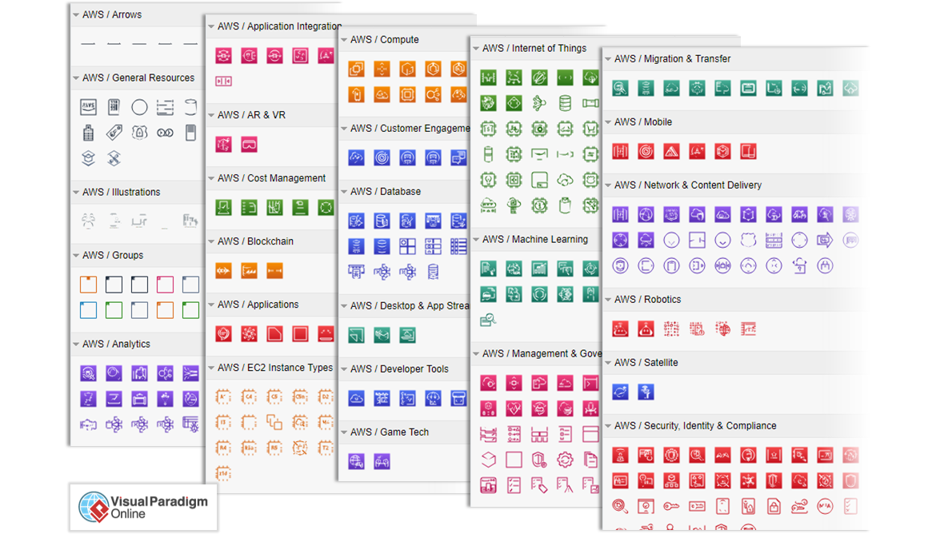
It might feel overwhelming, but …
People have created great pieces of software/hardware solutions to solve a lot of these requirements … But you need to know how to use them.

Slide 19
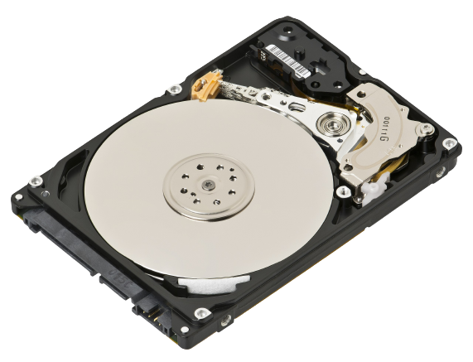
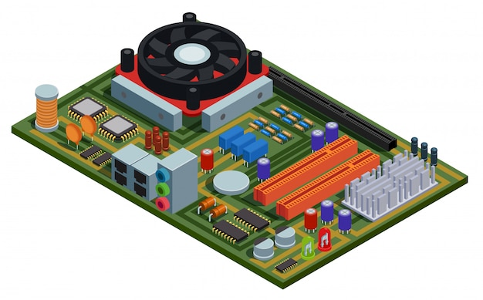
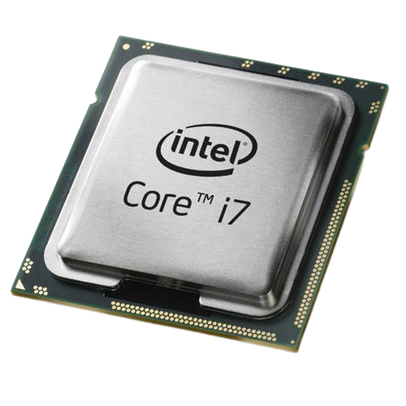
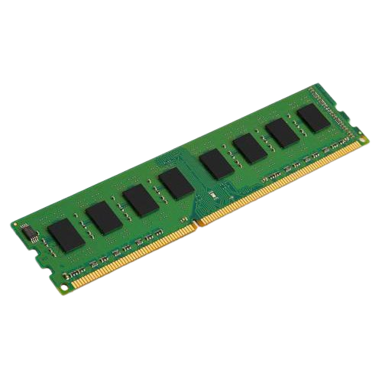
We only have to know a few to solve almost 95%+
And let’s start from basics … One computer first…

Slide 20
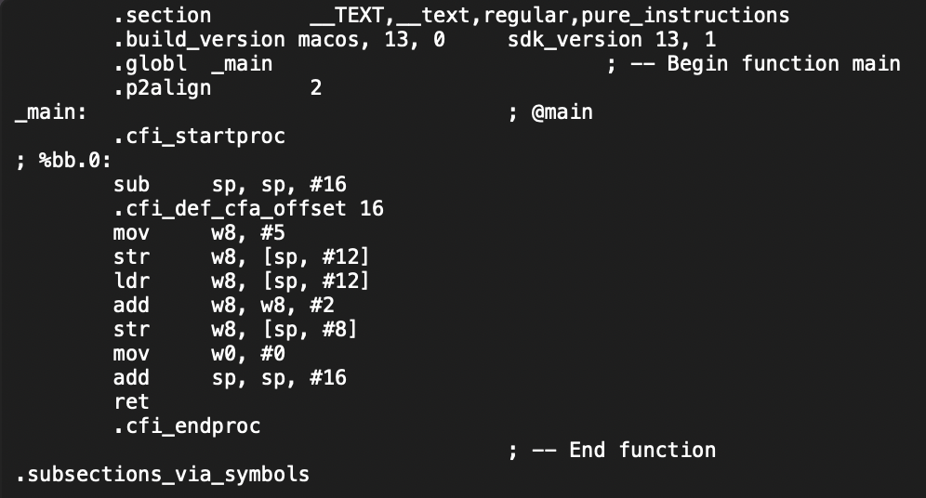
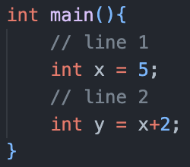
Whenever we write a code and compile …
test.s
test.c
Compile step
gcc -S -o test.s test.c

Slide 21
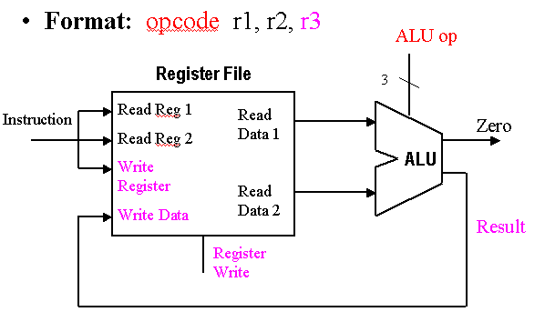
When we run the code … It runs in the CPU…
test.s
test.c
Compile step
gcc -S -o test.s test.c

Slide 22
The real world is complex… Multiple Codes Running…
test.s
test.c
Compile step
gcc -S -o test.s test.c
test.s
test.c
Compile step
gcc -S -o test.s test.c
test.s
test.c
Compile step
gcc -S -o test.s test.c

Slide 23
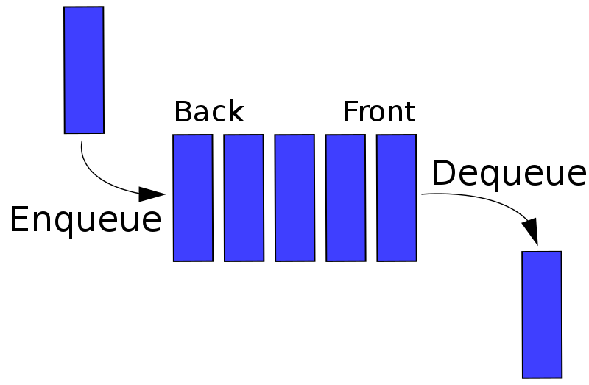
All needs to be done in a fair manner…
test.s
test.c
Compile step
gcc -S -o test.s test.c
test.s
test.c
Compile step
gcc -S -o test.s test.c
test.s
test.c
Compile step
gcc -S -o test.s test.c

Slide 24



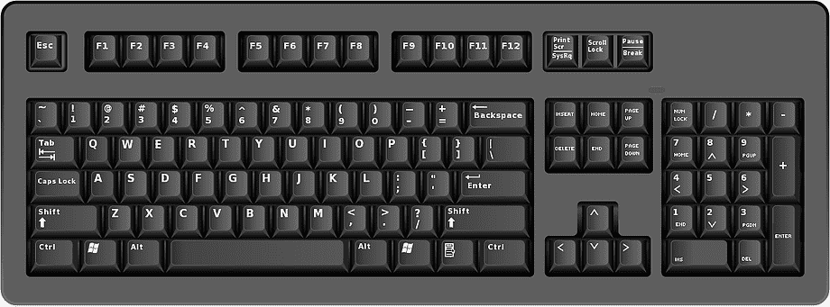
Program needs access to other Hardwares
test.s
test.c
Compile step
gcc -S -o test.s test.c
test.s
test.c
Compile step
gcc -S -o test.s test.c
test.s
test.c
Compile step
gcc -S -o test.s test.c

Slide 25

Multiple users use the same computer…
test.s
test.c
Compile step
gcc -S -o test.s test.c
test.s
test.c
Compile step
gcc -S -o test.s test.c
test.s
test.c
Compile step
gcc -S -o test.s test.c

Slide 26
But just like life… world inside computers are not simple…
OPERATING
SYSTEM

Slide 27

OS

Slide 28






Slide 29
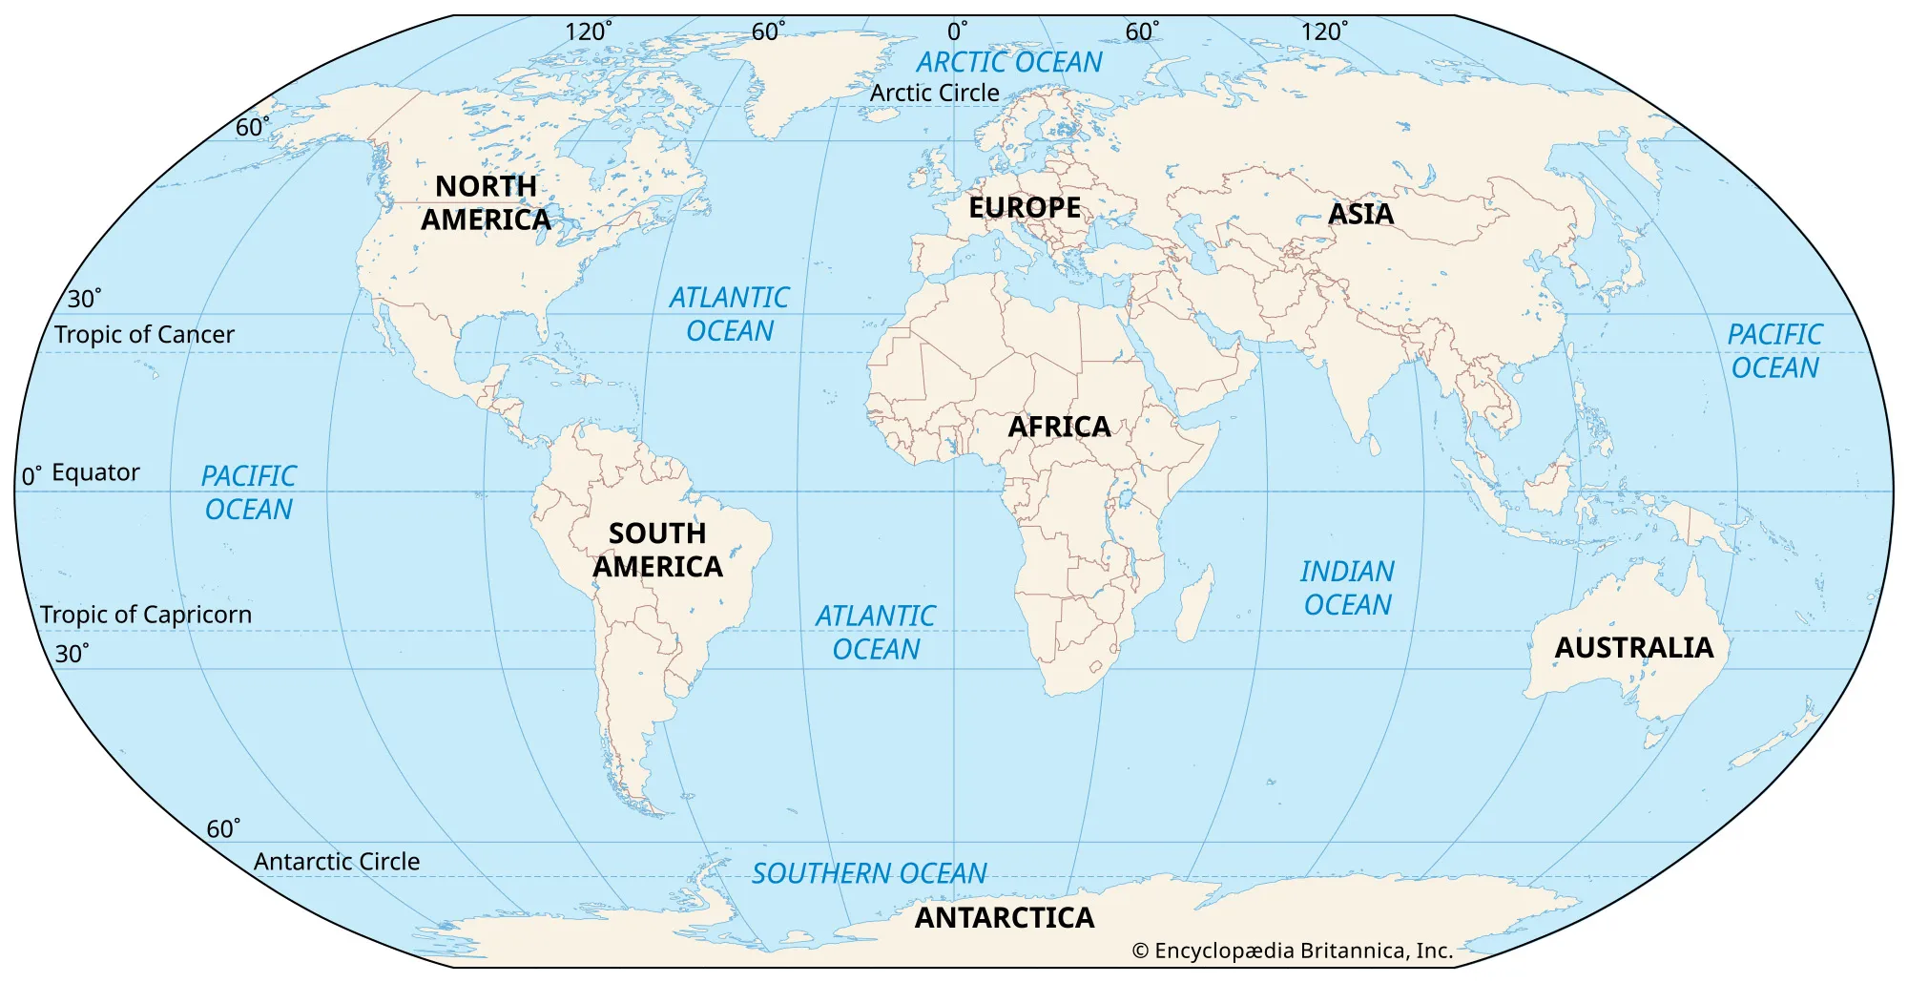
GET /counter
SELECT * from COUNTER

Slide 30
All these things are generally studied in Core CS subject.
System Design
Development
Core CS
Basic Programming + DSA

Slide 31
So now how do we scale this ??
counter = 2
GET /counter
SELECT * from COUNTER

Slide 32
Next, we will see the tools/techniques we have!
Performance (Latency)
Throughput (Capacity / QPS)
Scalability (Growth handling)
Availability (Uptime)
Reliability (Correctness under failures)
Consistency (Strong vs Eventual)
Durability (No data loss)
Security (Auth + Abuse protection)
Observability (Logs, Metrics, Tracing)
Maintainability / Operability (Safe changes & deployment)

Slide 33
Performance (Latency)
Throughput (Capacity / QPS)
Scalability (Growth handling)
Availability (Uptime)
Reliability (Correctness under failures)
Consistency (Strong vs Eventual)
Durability (No data loss)
Security (Auth + Abuse protection)
Observability (Logs, Metrics, Tracing)
Maintainability / Operability (Safe changes & deployment)
So now how do we scale this ??
GET /counter
SELECT * from COUNTER

Slide 34
GET /counter
SELECT * from COUNTER

Slide 35
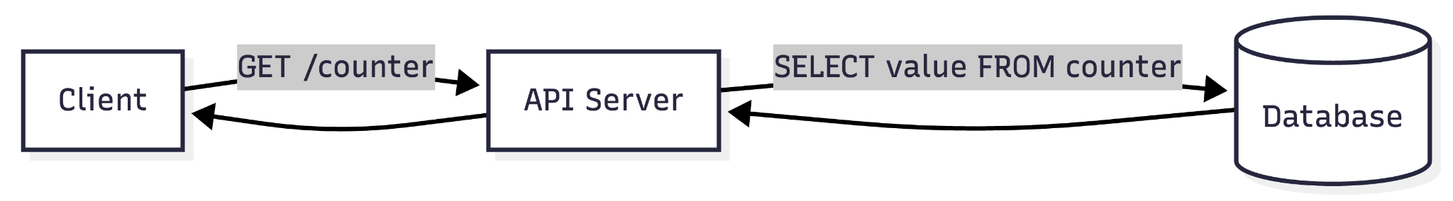
Latency : The Problem
1) Client → Server (network + TLS)
Same region (client nearby / good network): 10–50 ms
Cross-country / mobile / bad network: 50–200+ ms
TLS handshake (if new connection): adds 20–100 ms

Slide 36
Latency : The Problem
2) Server → DB (network inside data center/VPC)
Within same VPC / same region: 0.2–2 ms
Across AZ / slightly farther: 1–5 ms
(If DB is outside / VPN / public): can jump to 10–50 ms (avoid this)

Slide 37
GET /counter
SELECT * from COUNTER

Slide 38
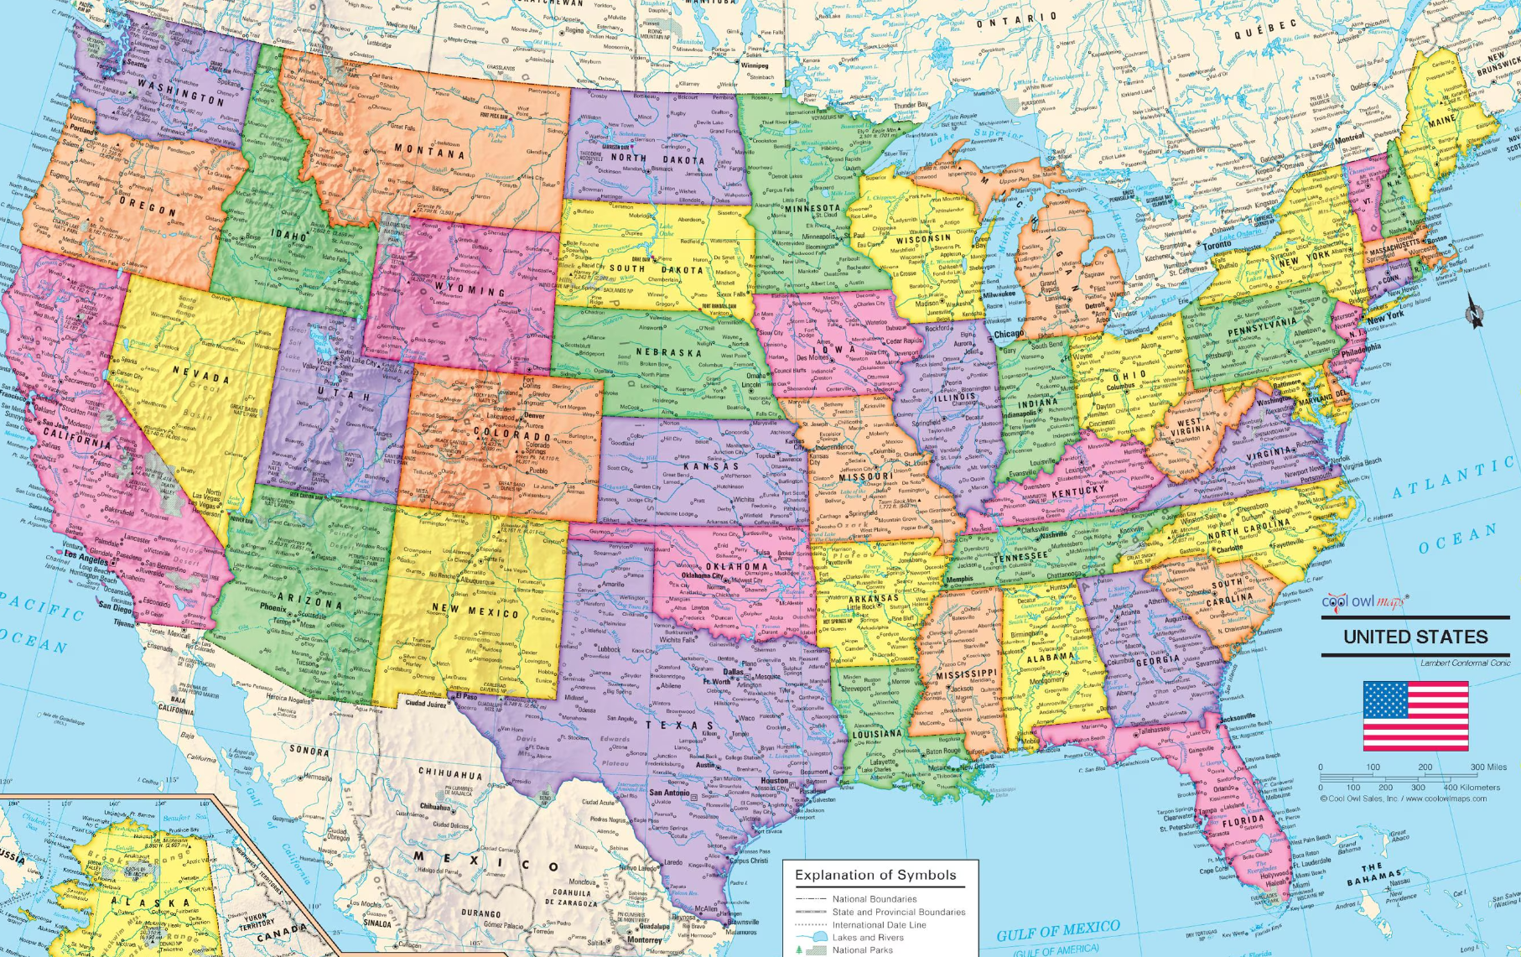

Slide 39
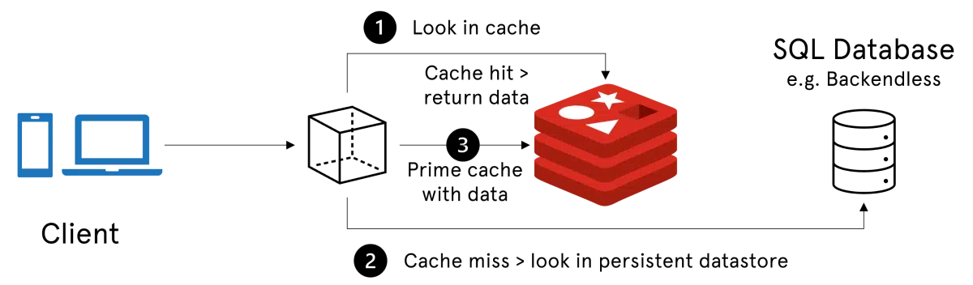
Performance (Latency) — reduce response time

Slide 40

Why Redis?
Think of almost Database,
but on RAM…
Extremely Fast…
ACID Properties available…
Readymade DS…
Can be scaled too!

Slide 43
OS

Slide 44
Throughput (Handle more QPS) — avoid server bottleneck
Rule-of-thumb QPS ranges (per instance)
A) “CPU-only” endpoint
(no DB, tiny response)
Examples: GET /health, cached /count, simple computations
1 vCPU: ~500–5,000 QPS
2 vCPU: ~1,000–10,000 QPS
4 vCPU: ~3,000–20,000 QPS
8 vCPU: ~8,000–50,000 QPS
B) “DB read per request” (like GET /count hitting Postgres)
1 vCPU: ~100–800 QPS
2 vCPU: ~200–1,500 QPS
4 vCPU: ~500–3,000 QPS
8 vCPU: ~1,000–6,000 QPS
(Usually DB or DB connection pool becomes the limiter before the EC2 CPU does.)
C) “DB write per request” (like POST /increment)
1 vCPU: ~50–400 QPS
2 vCPU: ~100–800 QPS
4 vCPU: ~250–1,500 QPS
8 vCPU: ~500–3,000 QPS

Slide 45
Scaling Instances
Vertical Scaling
Horizontal Scaling

Slide 46
GET /counter
SELECT * from COUNTER

Slide 47
GET /counter
SELECT * from COUNTER

Slide 49
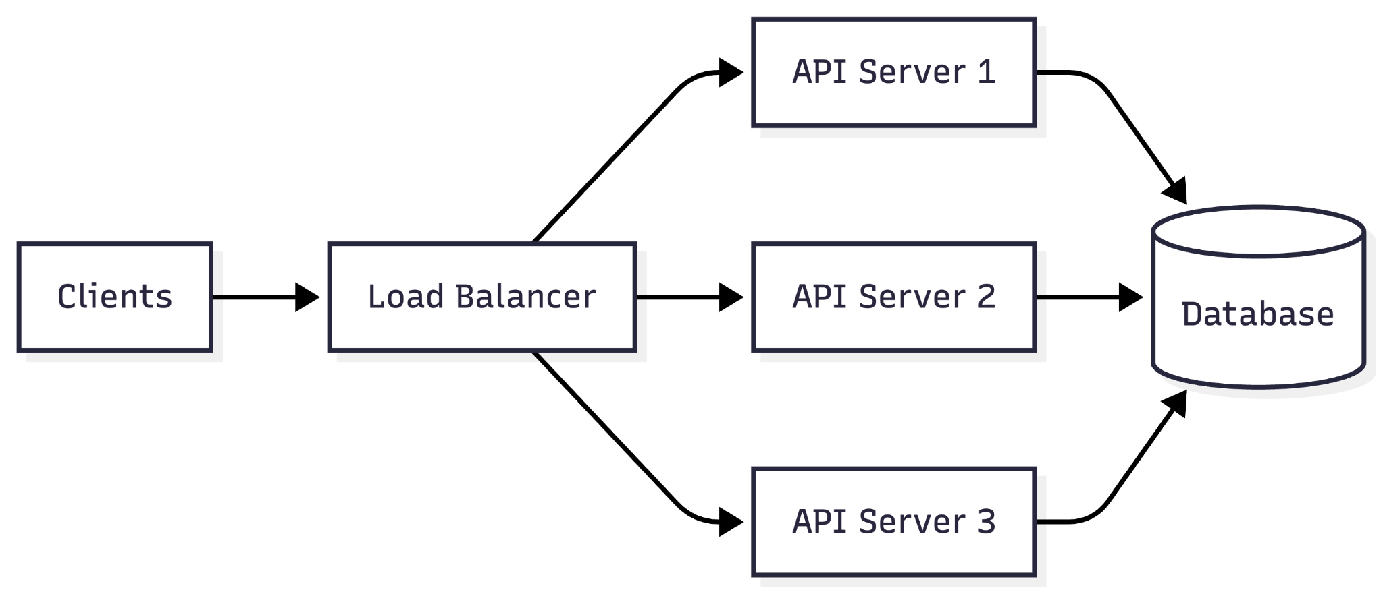
Throughput (Handle more QPS) — avoid server bottleneck

Slide 50
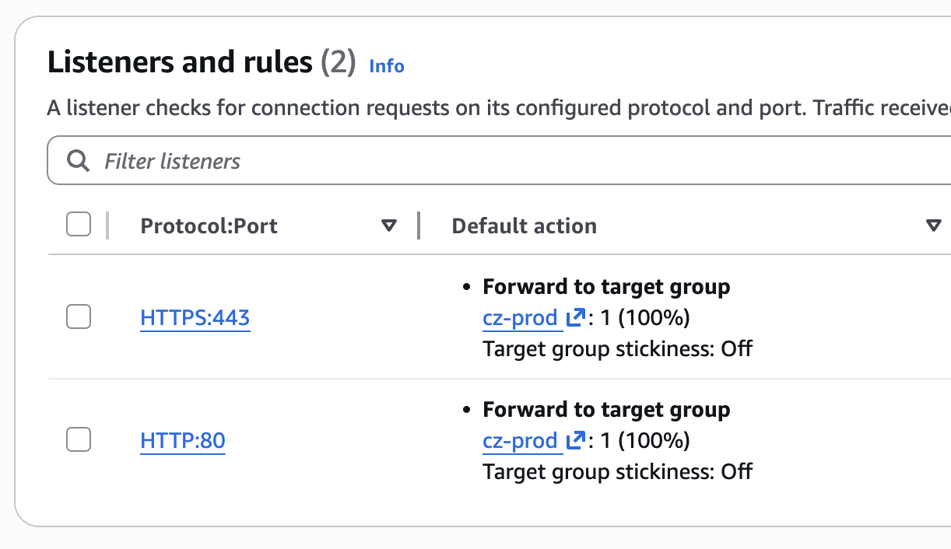
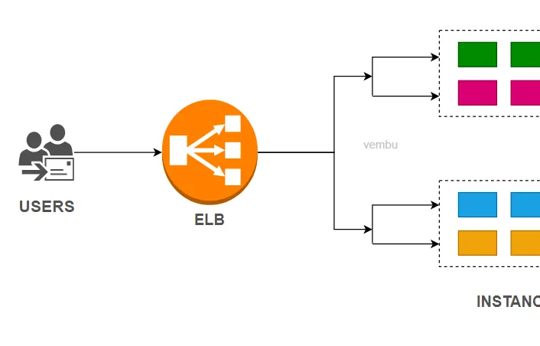
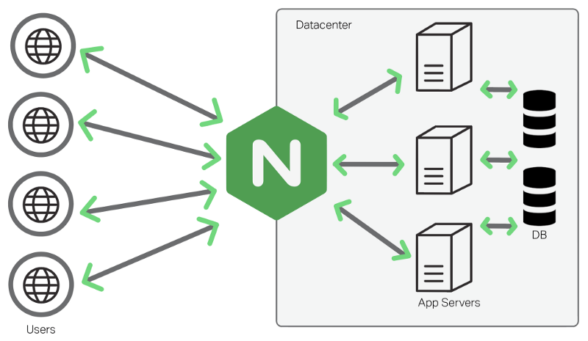
Load Balancer
Allows you to redirect traffic to multiple instances… part of target group.

Slide 51
Another Scalability issue
counter
2
GET /counter
SELECT * from COUNTER

Slide 52
Another Scalability issue
POST /incr
counter
2
POST /incr

Slide 53
Another Scalability issue
counter
1
POST /incr
GET /incr
counter
2

Slide 54
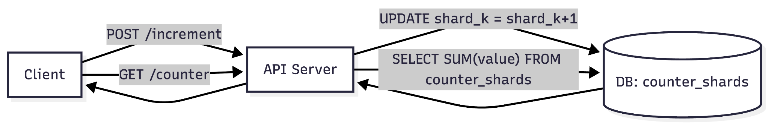
Scalability — scale increments without one-row bottleneck

Slide 55
Next, Availability issue…
counter
1
POST /incr
GET /incr
counter
2

Slide 56
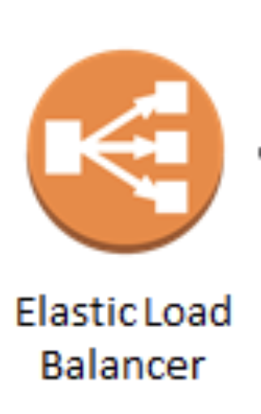
Next, Availability issue…
counter
1
counter
2

Slide 57
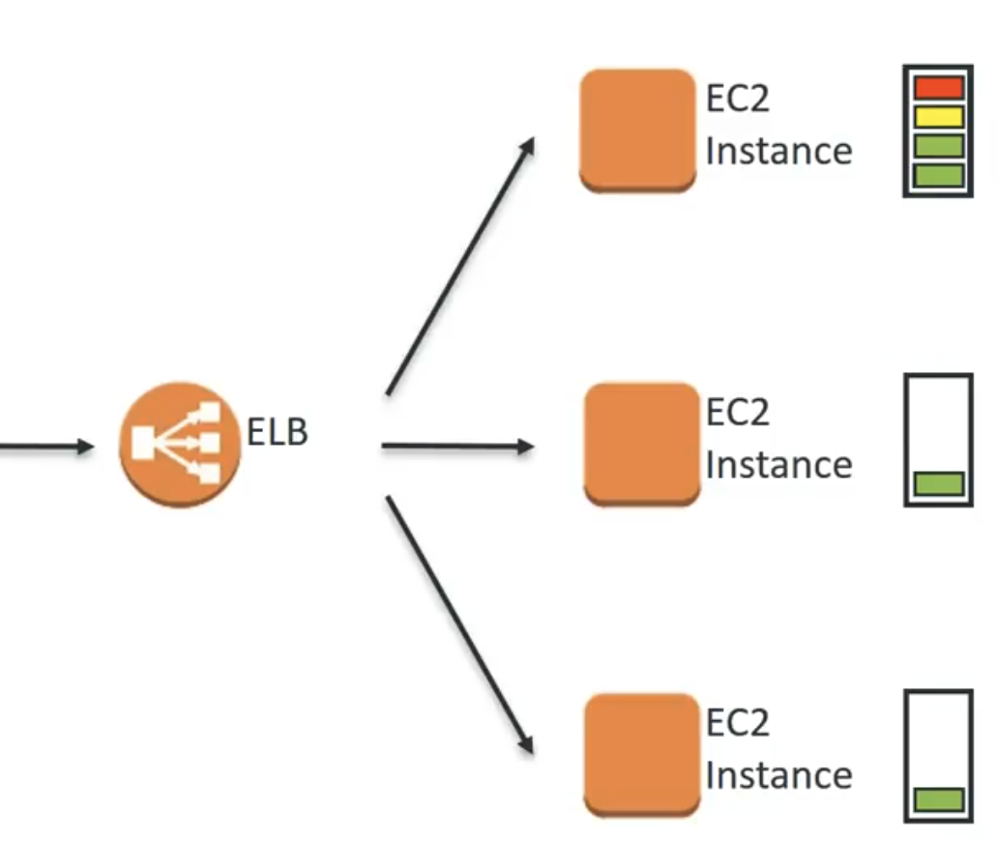
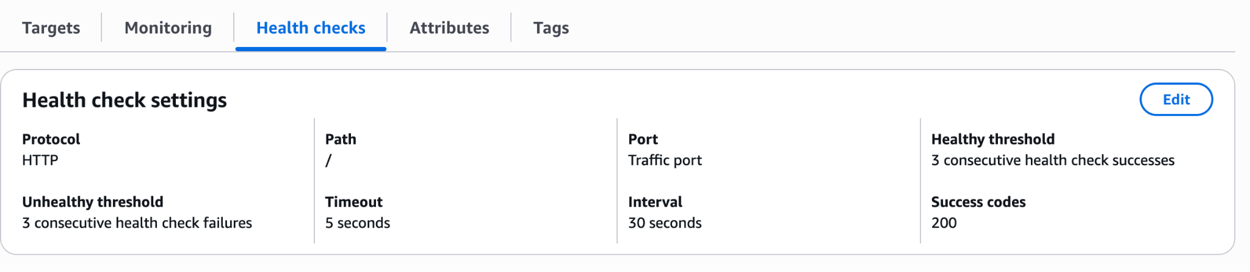
Healthcheck Concept
LB can keep checking and move traffic
away from unhealthy instances

Slide 58
Next, Availability issue…
counter
1
counter
2

Slide 59
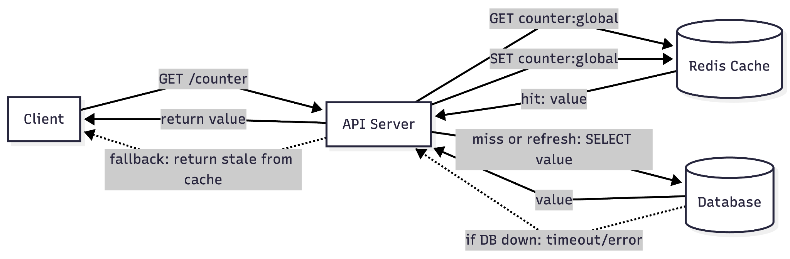
Availability (Uptime) — keep serving even if DB fails

Slide 60
Reliability Issue …
GET /counter
SELECT * from COUNTER

Slide 61
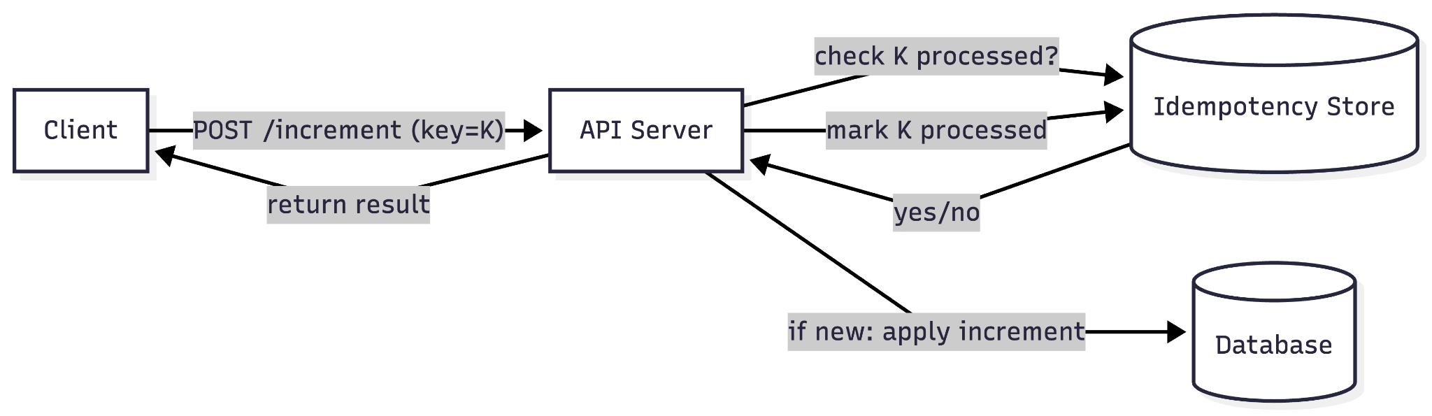
Reliability (Retries) — Idempotency Key Store

Slide 62
Consistency - Strong

Slide 63
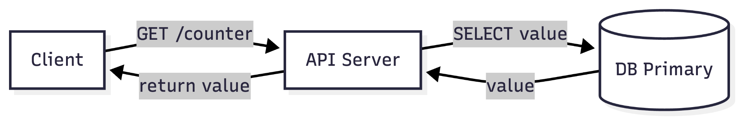
Consistency - Option A (Strong Consistency: Read Primary)

Slide 64

Consistency - Eventual
3

Slide 65
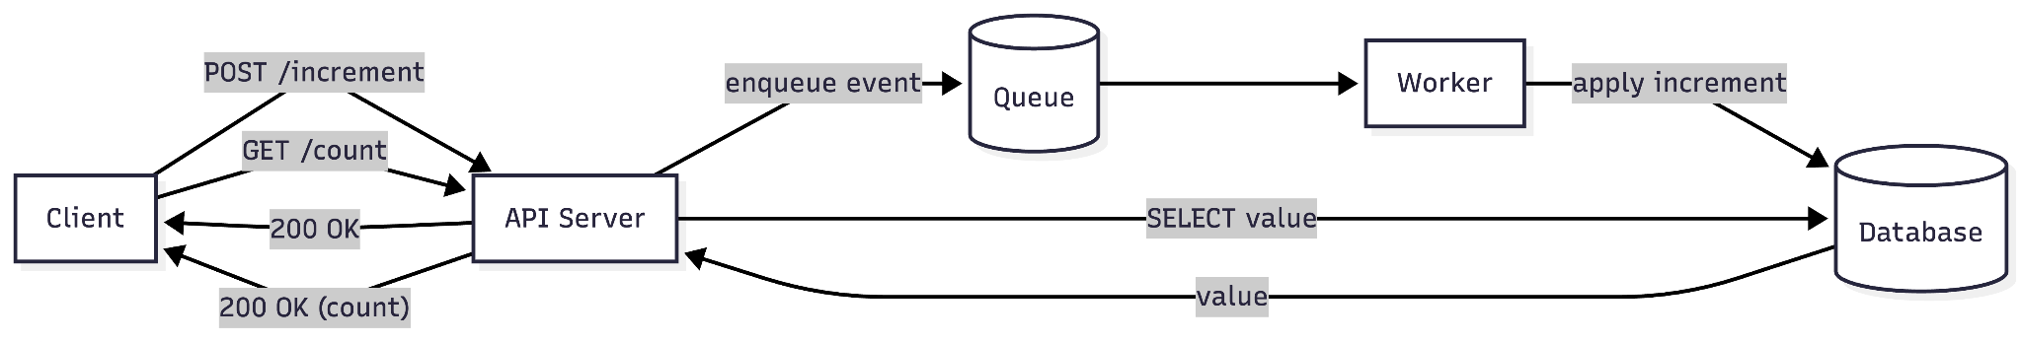
Option B (Eventual Consistency: Async updates)

Slide 66
Durability — Durable Queue as Commit Point

Slide 67



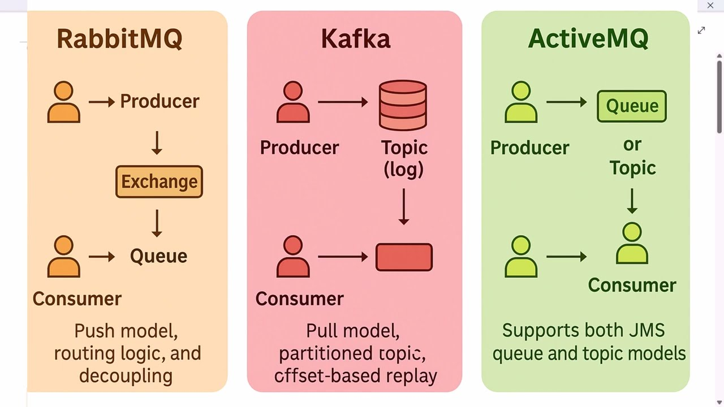

Slide 68
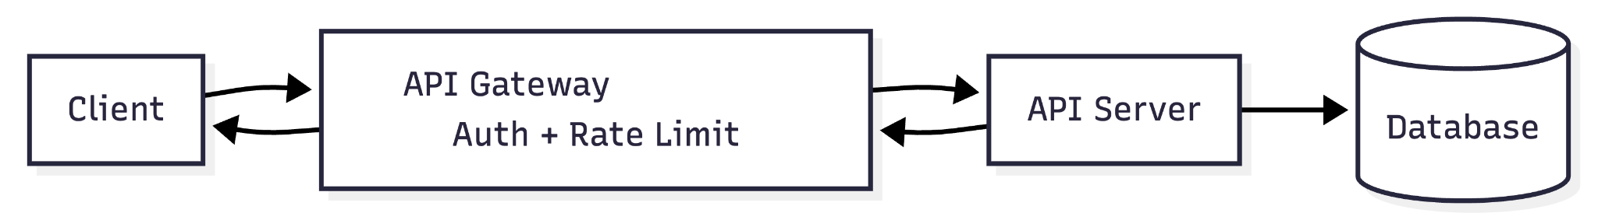
Security — API Gateway (Auth + Rate Limit)
Authentication & Authorization – verify identity (JWT/API key/OAuth) and enforce permissions.
Rate Limiting / Throttling – control traffic per user/IP/API to prevent abuse and overload.
Load Balancing / Routing – route requests to the right service/instance; distribute load; health checks.
Caching – cache common responses to reduce latency and backend load.
Request / Response Transformation – rewrite paths/headers, validate schemas, convert formats (JSON ↔ XML), add/remove fields.
Service Discovery Integration – find live service instances dynamically (especially in microservices/Kubernetes).
Circuit Breaking / Timeouts / Retries – stop calling failing services, fail fast, and avoid cascading failures.

Slide 69
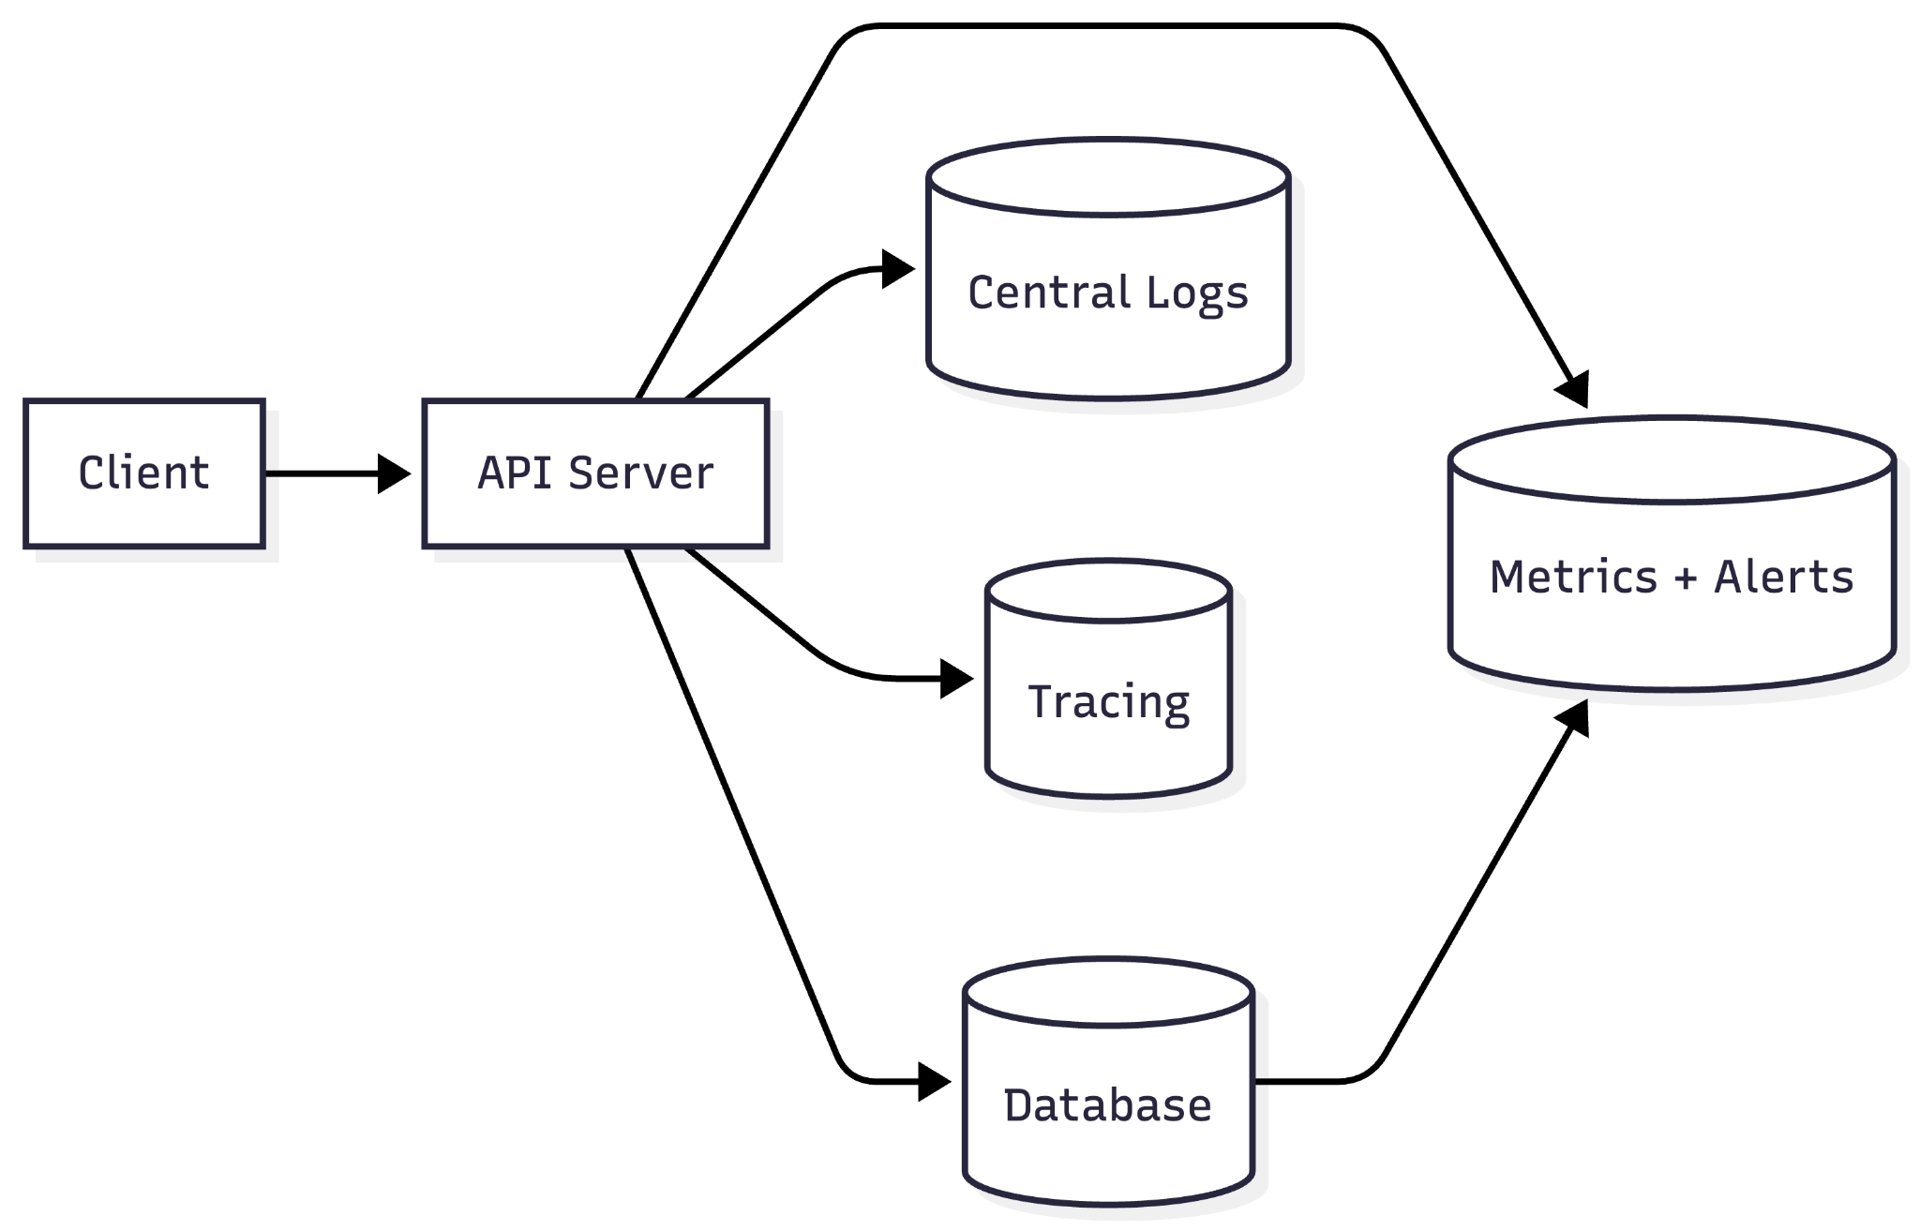
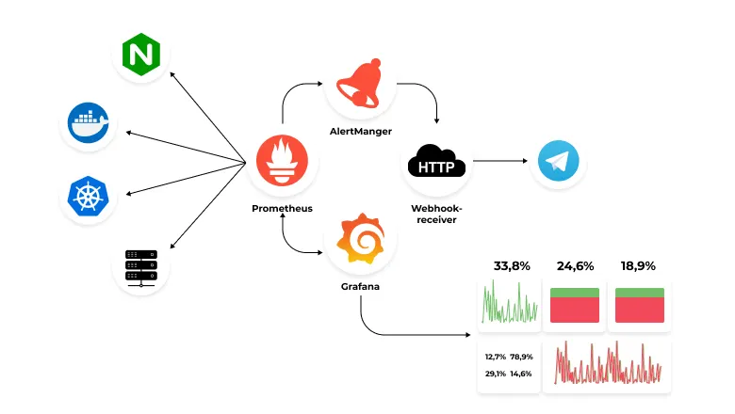
Observability —
Metrics, Logs, Tracing

Slide 70
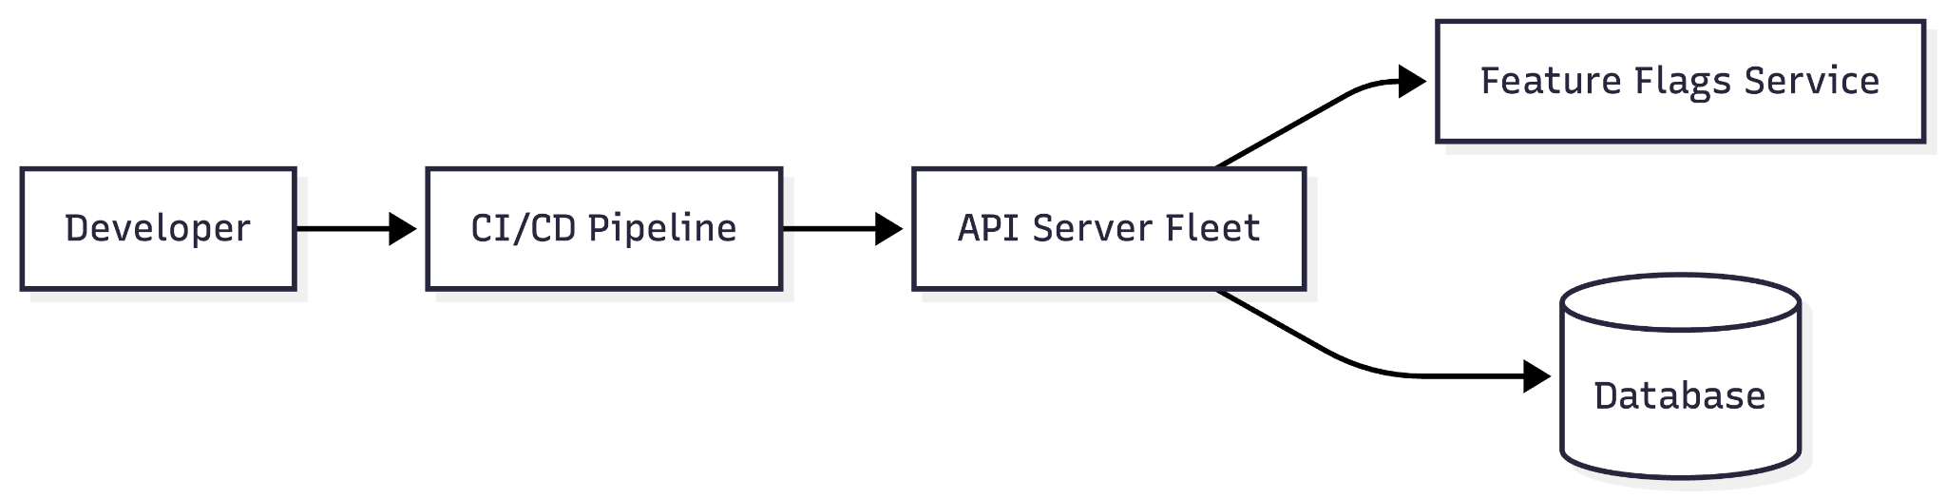
Maintainability / Operability — CI/CD + Feature Flags

Slide 71
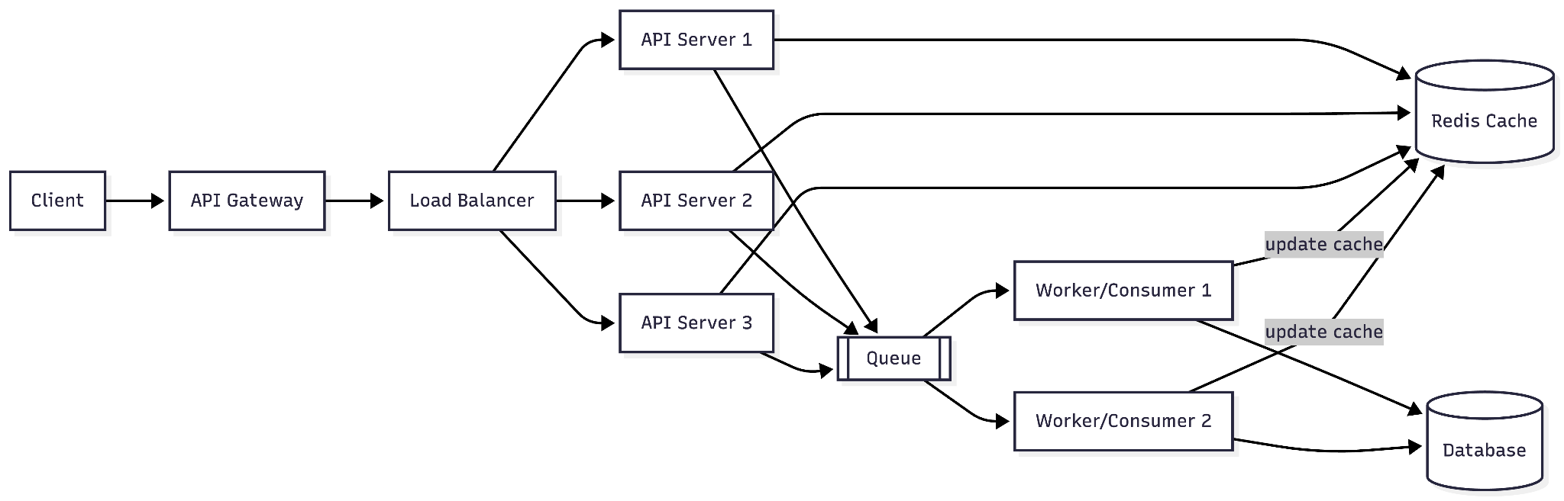
For now remember the following pieces…

Slide 72
Before we now proceed, we need to learn some more key concepts…

Slide 73
The Goal for us is to have a
Interview Framework

